Slide 1
Mindset, Mathematics, and Motivation “Is There An App For That?” TLCA Capstone Project
Donna Lione
Math Specialist / Coach
Temecula Valley Unified School District
May 2015

Slide 2
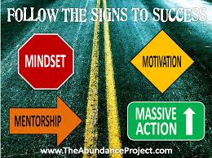
Project Rationale
Building a growth mindset in at-risk students and their teachers will lead to increased academic achievement in mathematics.

Slide 3
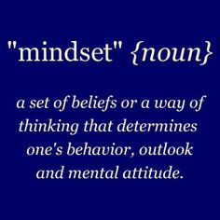
Project Overview
Mindset, Motivation, & Mathematics is an action project designed to influence other educators to embrace the innovative teaching style of a growth mindset to promote mathematics achievement for ALL students. Instructional and common core strategies coupled with a strong foundation in number sense are at the forefront of this unique approach to teaching Algebra I to at-risk students.
Notes:
Mindset, Motivation, & Mathematics is an action project designed to influence other educators to embrace the innovative teaching style of a growth mindset to promote mathematics achievement for ALL students. Instructional and common core strategies coupled with a strong foundation in number sense are at the forefront of this unique approach to teaching Algebra I to at-risk students.

Slide 4
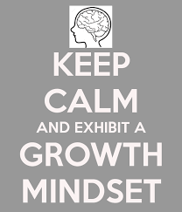
Vision Statement
Instill a Growth Mindset in at-risk students to increase student motivation, self-efficacy, and encourage students to take high-level math courses throughout their high school years.
Notes:
Instill a growth mind-set in at-risk students to increase student motivation, self-efficacy, and encourage students to take high-level math courses throughout their high school years.

Slide 5
Project Goals
Embrace mistakes as opportunities for growth.
Measure At-Risk student’s perceptions.
Student participation in on-line “Brainology” and “PERT” Models – Stanford University.
Demonstrate that student ability and intelligence can be developed and increased through productive struggle.
“Growth Mindset” phrases and instructional practices will be part of everyday classroom discourse.
As a “Teacher Leader”, I will motivate teachers to accept and teach a Growth Mindset for ALL students.

Slide 6
Teacher Leader Model Standards
Notes:
Detailed Explanations for each standard on dlione.weebly.com

Slide 7
Research
Notes:
All research links and references on dlione.weebly.com

Slide 8
Timeline
Notes:
Detailed timeline explanations on dlione.weebly.com

Slide 9
Mindset Student Survey
Notes:
Mindset student survey completed on August 14, 2014
Mindset student survey completed on May 10, 2015

Slide 10
District Semester 1 Assessment
Notes:
Semester 1 District Assessment – December 2014

Slide 12
Next Steps
2015-2016 teacher & student participation in Stanford’s Growth Mindset PERTS project.
Continued work with Jo Boaler, Stanford University “How Kids Learn Math”.
Site level –increase PD on Growth Mindset In staff meetings and PLCs.
Co-Teaching Model with Geometry - Growth Mindset instructional teaching practices.
2nd Round of Freshman Hybrid “Growth Mindset” Algebra 1 class 2015-2016

Slide 13
Reflection and Growth
Notes:
Detailed explanations on dlione.weebly.com

Slide 14
October 2014 LPTI #1
Areas of Growth:
Areas Needing Growth:

Slide 15
May 2015 - LPI #2
Areas of Growth:
Areas Still Needing Growth:

Slide 16
Mindset Resources
Notes:
To View All Sources Referenced On the Brain, You Must Be In Presentation Mode so that it links to www.thinglink.com

